Slide 1
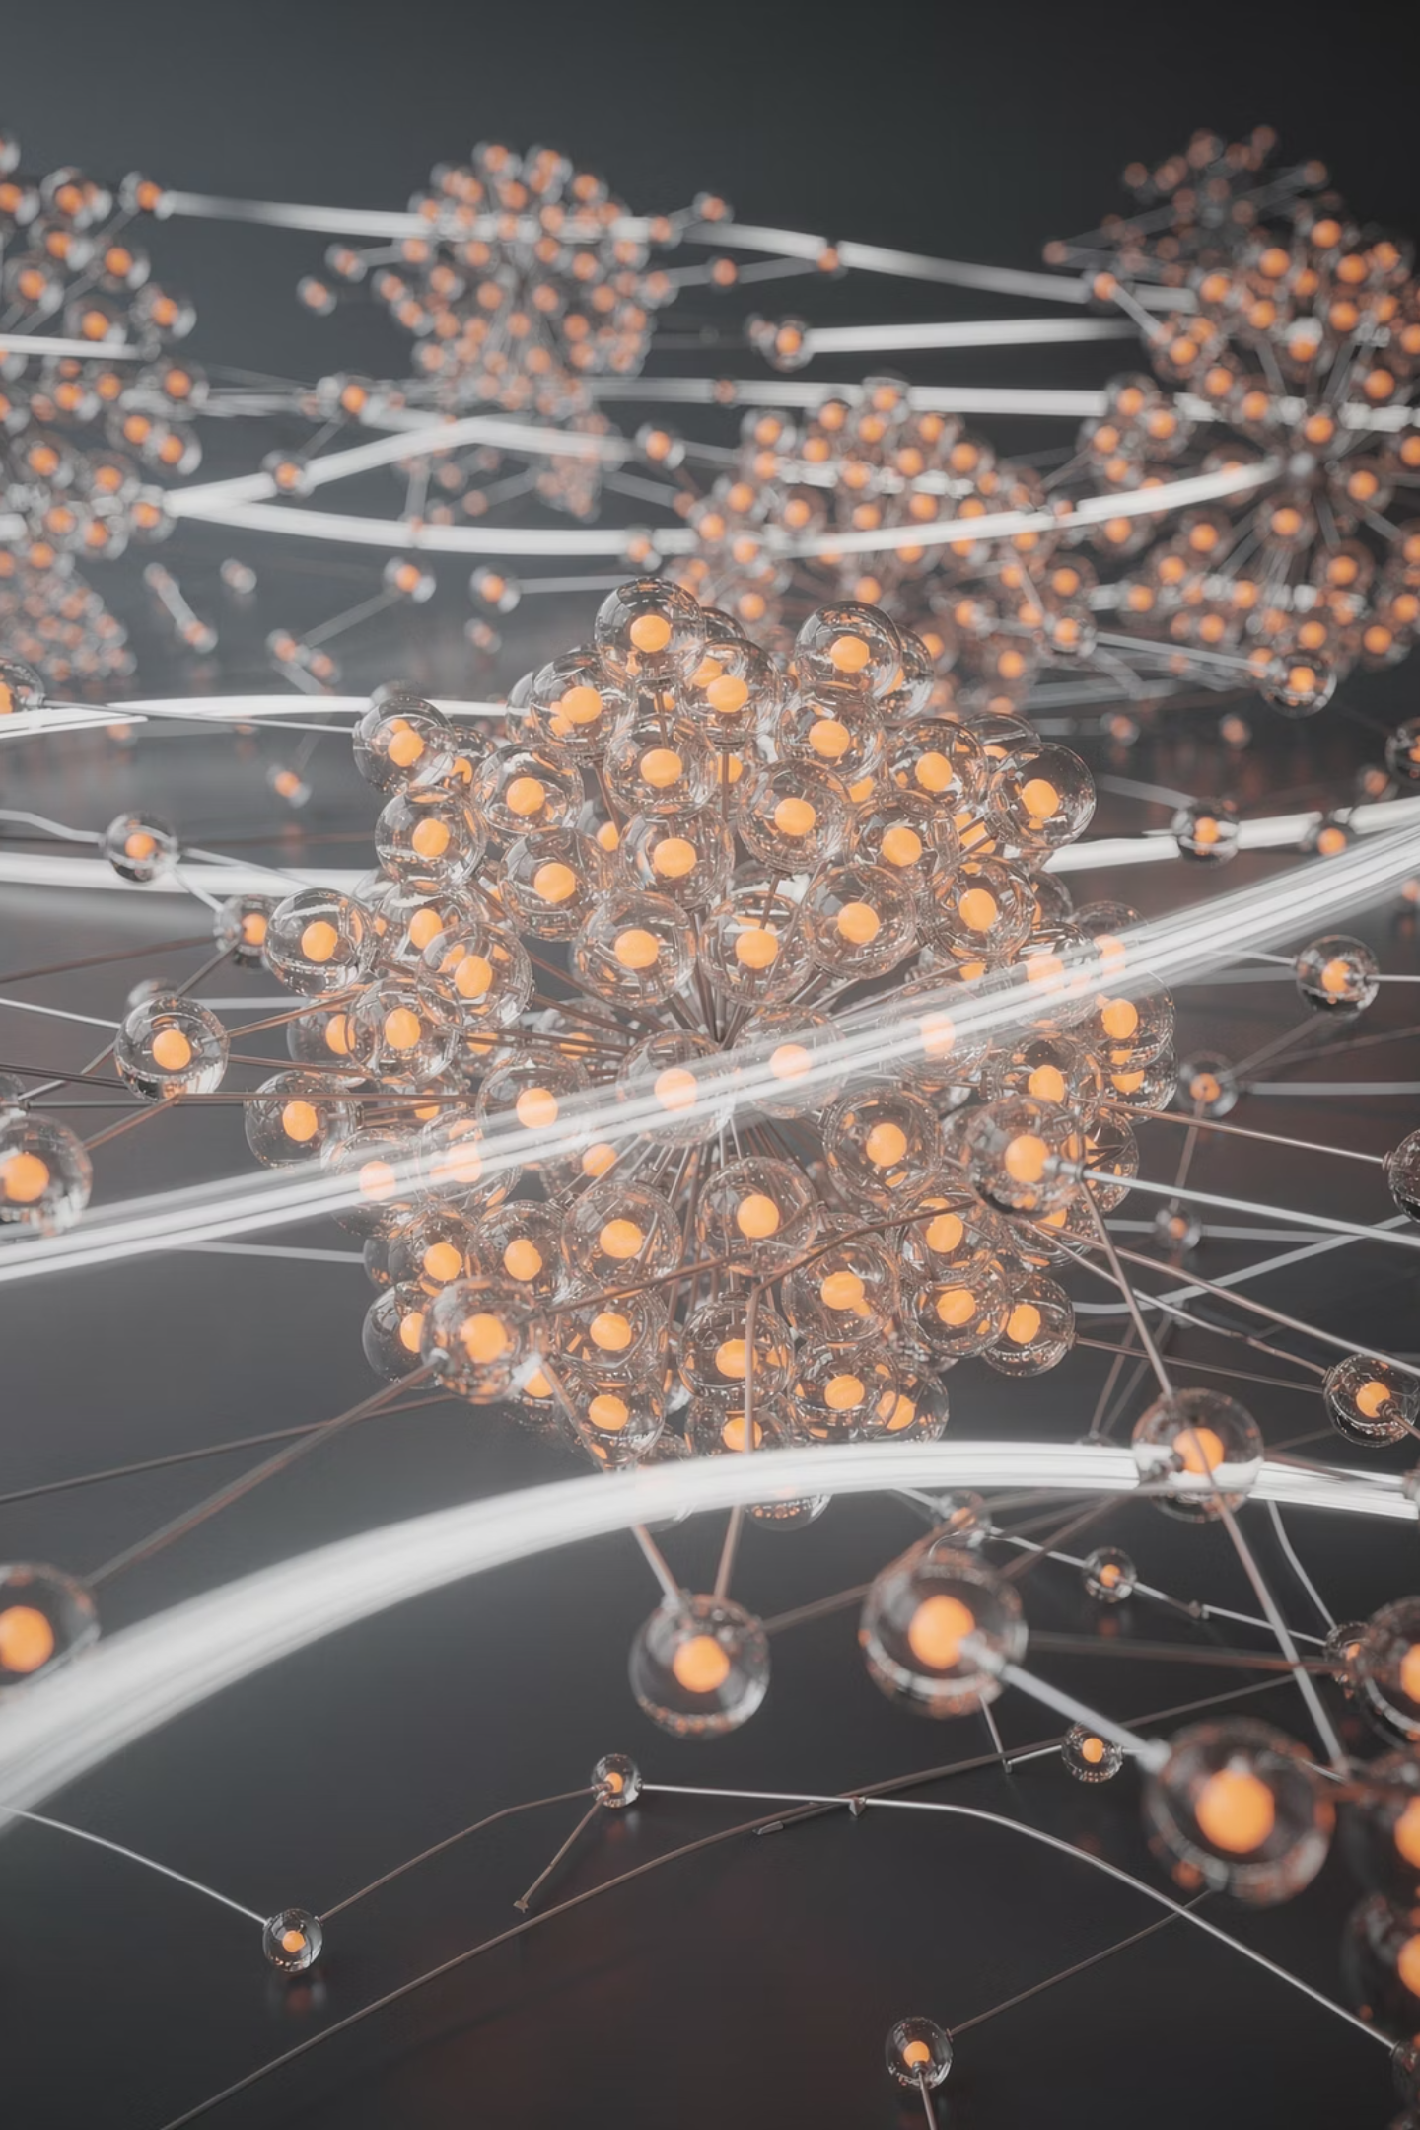
The Future of Boosting, AutoML & Explainable AI
Exploring the convergence of next-generation machine learning paradigms

Slide 2
Contents
01
02
Why the Future Is Changing
The Evolution of Boosting Algorithms
03
04
Next-Gen Boosting Trends
The Rise of AutoML
05
06
Future Directions of AutoML
Explainable AI (XAI): Why It Matters
07
08
Future Trends in Explainable AI
Convergence: Boosting + AutoML + XAI

Slide 3
Why the Future Is Changing
The machine learning landscape is undergoing a fundamental shift driven by four converging forces. Model complexity continues to escalate, making interpretation and deployment increasingly difficult. Regulatory pressure — from the EU AI Act to sector-specific mandates — now demands transparency and accountability from automated decision systems.
Simultaneously, business leaders require interpretable outputs they can act on with confidence, not opaque predictions. And the competitive environment demands faster deployment cycles, compressing the timeline from research prototype to production system. Together, these forces are reshaping how we build, deploy, and govern ML models at every level.

Slide 4
The Evolution of Boosting Algorithms
1. AdaBoost
The original adaptive boosting framework
3. XGBoost
Regularization & speed gains
2. Gradient Boosting
Generalized loss optimization
4. LightGBM / CatBoost
Scalability & categorical handling
Boosting algorithms have evolved from simple adaptive reweighting to highly optimized, scalable frameworks. The focus has shifted toward scalability and efficiency, enabling training on massive datasets. Hybrid models now combine boosting with deep learning architectures, leveraging the strengths of both paradigms. Despite the rise of transformers and large language models, boosting maintains continued dominance on tabular datasets — the backbone of enterprise analytics.

Slide 5
Next-Gen Boosting Trends
The next wave of boosting innovation extends far beyond algorithmic speed. These four frontiers are redefining what boosting frameworks can achieve in production environments.
1. Auto Feature Engineering
Automated feature construction and selection embedded directly within boosting pipelines, reducing manual preprocessing effort.
3. Edge Deployment
Optimized boosting models deployed on edge devices for low-latency inference in IoT and real-time applications.
2. Foundation Model Integration
Combining boosting with large pretrained models to leverage learned representations for richer tabular predictions.
4. Privacy-Preserving Boosting
Federated and differential privacy approaches enabling collaborative model training without exposing sensitive data.

Slide 6
The Rise of AutoML
AutoML emerged to address a critical bottleneck: the global shortage of skilled data scientists. By automating model selection, hyperparameter tuning, and feature engineering, AutoML platforms dramatically accelerate experimentation cycles — reducing weeks of manual work to hours.
Automated Selection
Algorithm and hyperparameter search without manual intervention
Faster Experiments
Rapid iteration from hypothesis to validated model
Democratization
Domain experts can build ML models without deep coding expertise

Slide 7
Future Directions of AutoML
AutoML is evolving from a model-building tool into an autonomous decision-making platform. The trajectory points toward fully self-managing ML ecosystems.
AI Agents Managing Full Workflows
Autonomous agents orchestrate data ingestion, cleaning, modeling, and deployment end-to-end — minimizing human-in-the-loop overhead.
Continuous Learning Pipelines
Models that retrain and adapt automatically as data distributions shift, maintaining accuracy over time without manual retraining.
Domain-Aware AutoML
Systems that encode domain knowledge — healthcare constraints, financial regulations — directly into the search and optimization process.
From Auto Modeling → Auto Decision Systems
The paradigm shift from automating model creation to automating entire decision workflows, including monitoring, alerting, and action.

Slide 8
Explainable AI (XAI): Why It Matters
As ML models grow more powerful, they also grow more opaque. Black-box challenges in modern ML create serious risks — biased outcomes, unexplainable decisions, and eroded stakeholder trust. XAI addresses these challenges head-on.
Transparency
Stakeholders need to understand why a model made a specific prediction, not just what it predicted.
Fairness & Regulation
Healthcare and finance regulations increasingly mandate explainability for automated decisions affecting individuals.
Trust Building
Clinicians, loan officers, and executives adopt ML only when they can verify and trust the reasoning behind outputs.
"If you can't explain it simply, you don't understand it well enough." — A guiding principle for deploying AI in high-stakes domains.

Slide 9
Future Trends in Explainable AI
XAI is rapidly maturing from post-hoc analysis into a core component of the ML development lifecycle. Four key trends are shaping its trajectory.
Real-Time Explanations
Generating interpretable outputs at inference time, enabling instant justification for each prediction in production systems.
Standardized Metrics
Industry-wide explanation quality metrics — fidelity, stability, comprehensibility — enabling objective comparison across methods.
Automated Bias Detection
Continuous monitoring pipelines that flag fairness violations and distributional drift before they cause downstream harm.
Built-In Explainability
ML platforms embedding XAI natively, so explainability is a default feature rather than an afterthought or add-on.

Slide 10

Convergence: Boosting + AutoML + XAI
Automated Training
AutoML Selects Boosting
XAI Real‑time Explainations
Self‑operating Monitoring
The most transformative development is the convergence of these three paradigms into unified, self-operating ML systems. AutoML selects and tunes optimal boosting models. Automated pipelines handle training and deployment. XAI generates transparent explanations for every prediction. Continuous monitoring closes the loop — creating intelligent systems that build, explain, and govern themselves with minimal human intervention.

Slide 11
Key Takeaways
Boosting Remains Dominant
Boosting algorithms continue to lead on tabular data, evolving with hybrid deep learning integration, edge deployment, and privacy-preserving techniques.
XAI Is Non-Negotiable
Regulatory mandates and stakeholder trust demand built-in explainability with real-time explanations, bias detection, and standardized metrics.
AutoML Democratizes ML
AutoML is shifting from automated modeling to autonomous decision systems — managed by AI agents with domain awareness and continuous learning.
Convergence Is the Future
The integration of Boosting, AutoML, and XAI into self-operating ML systems represents the next frontier of intelligent, transparent, and scalable AI.

